Slide 1
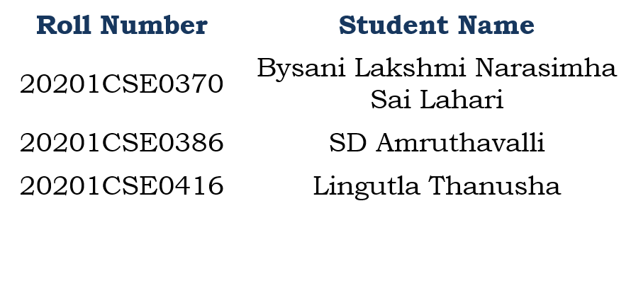
PROJECT TITLE: Protecting Patient Medical Data
PIP104 PROFESSIONAL PRACTICE-II
VIVA-VOCE
Batch Number:G66
Under the Supervision of,
Dr. Prakash Shanmurthy
Assistant Professor
School of Computer Science & Engineering
Presidency University

Slide 2
INTRODUCTION
In today’s digital age, storing patient medical records has become a cornerstone of modern healthcare. It is not only compliant but a fundamental commitment to protect sensitive patient data.
In the digital age where electronic health records and interconnected healthcare systems have become the norm, protecting sensitive patient data is of utmost importance.
In this presentation, we discuss the critical importance of keeping medical records confidential and secure. We will explore the challenges, ethical and legal obligations and solutions addressed by our final year project.

Slide 3
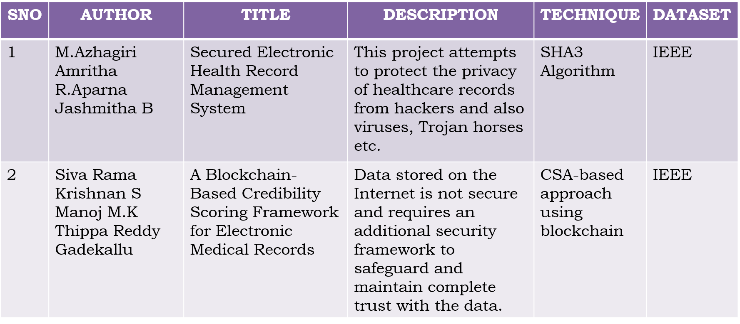
Literature Review

Slide 4
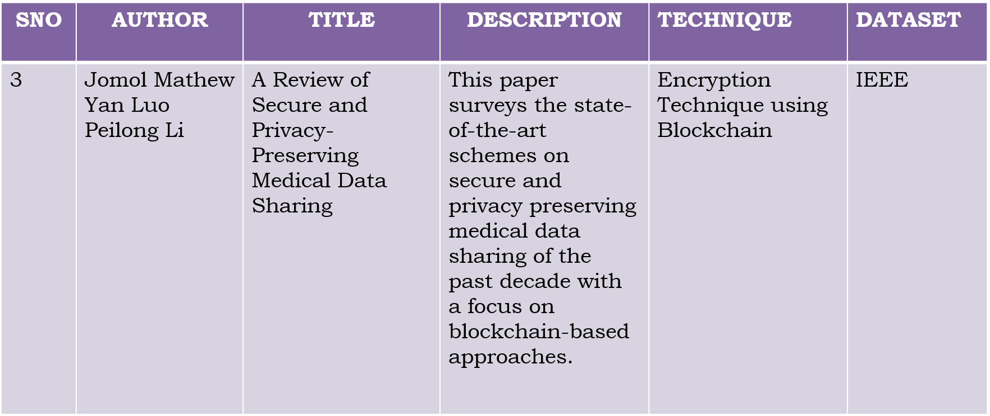
Literature Review

Slide 5
Research Gaps Identified

Slide 6
Proposed Methodology
Our proposed scheme is based on the cipher text policy attribute-based encryption (CP-ABE) and proxy re-encryption (PRE).
In addition, we introduce a policy versioning technique to support the full traceability of policy changes. Finally, we conducted the performance evaluation to demonstrate the efficiency of the proposed scheme .

Slide 7
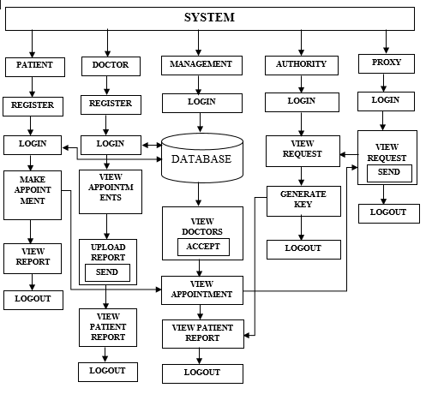
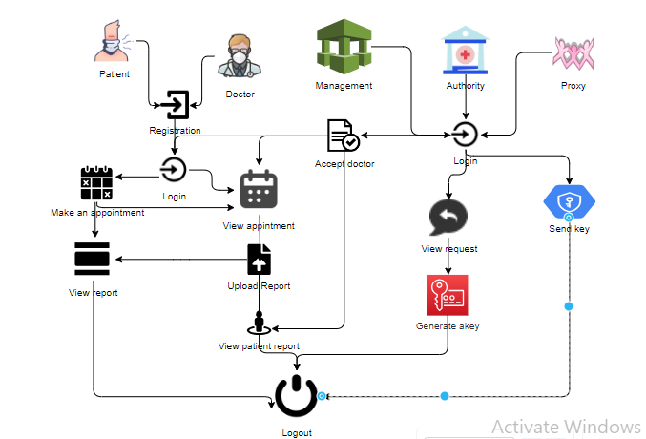
Proposed Architecture

Slide 8
Objectives
Protect patient data from unauthorized access.
Maintain confidentiality and trust with patients.
Monitor record access to ensure data security.

Slide 9
System Design & Implementation

Slide 10
Timeline of Project

Slide 11
Outcomes / Results Obtained
1. Trust and Patient Engagement:
Patients are more likely to interact openly and trust their doctors, creating an environment conducive to accurate information sharing and collaborative communication.
2. Compliance and Mitigation:
Strict compliance with data protection requirements to comply with the law, protect healthcare organizations from legal consequences, and reduce concerns about criminal information.
3. Enhanced Data Security:
Privacy measures reduce the risk of unauthorized access, protecting patient information from possible leaks, identity theft and unauthorized access.
4. Honesty and Integrity Policy:
Based on standards of medical ethics before patient confidentiality and promotes the honesty and ethical practices of medical professionals.
5. Improve Healthcare and Outcomes:
Access to confidential and accurate medical information allows doctors to make informed decisions, resulting in personalized care and ultimately better outcomes and health.

Slide 12
Conclusion
In our project, focused on securing patient medical records. We've emphasized compliance with regulations, robust security, education, and continuous monitoring.
This project aims to ensure data safety, patient trust, and legal adherence. We look forward to upholding these principles and making a positive impact on healthcare.

Slide 13
References
Barrows RC Jr, Clayton PD. Privacy, confidentiality, and electronic medical records. J Am Med Inform Assoc. 1996;3:139–148.
Y. Kawai, ‘‘Outsourcing the re-encryption key generation: Flexible ciphertext-policy attribute-based proxy re-encryption,’’ in Proc. Int. Conf. Inf. Secur. Pract. Exper. (ISPEC), Beijing, China, 2015, pp. 301–315.
L. Touati and Y. Challal, ‘‘Instantaneous proxy-based key update for CPABE,’’ in Proc. IEEE 41st Conf. Local Comput. Netw. (LCN), Dubai, United Arab Emirates, Nov. 2016, pp. 591–594.
K. Yang, X. Jia, and K. Ren, ‘‘Secure and verifiable policy update outsourcing for big data access control in the cloud,’’ IEEE Trans. Parallel Distrib. Syst., vol. 26, no. 12, pp. 3461– 3470, Dec. 2015.

Slide 14
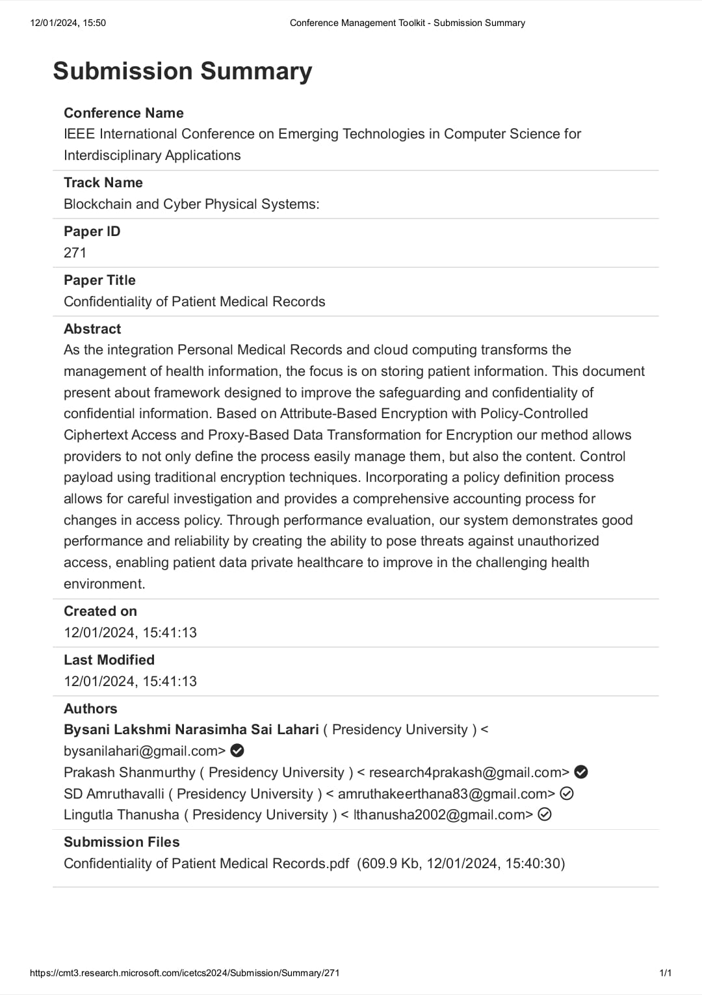
Publication Details

Slide 15
Achievements (if any)

Slide 16

Thank You

